Slide 1
Annual Time-Series Analysis with GridLAB-D

Slide 2
Time-series Simulations
A power flow solution is for a single point in time.
Time series simulations are necessary for analysis other than “peak capacity” planning.
Time-series simulations are a series of power flow solutions.
This is not the same as transmission level dynamic or electromagnetic simulations.

Slide 3
Time-series Simulations
State (x)
Δx
Δt
Time (t)

Slide 4
Time-series Simulations cont.
Daily cycles: 24 hours
Weekly Cycles: Weekday vs. Weekend
Seasonal Cycles: Fall, Winter, Spring, Summer

Slide 5

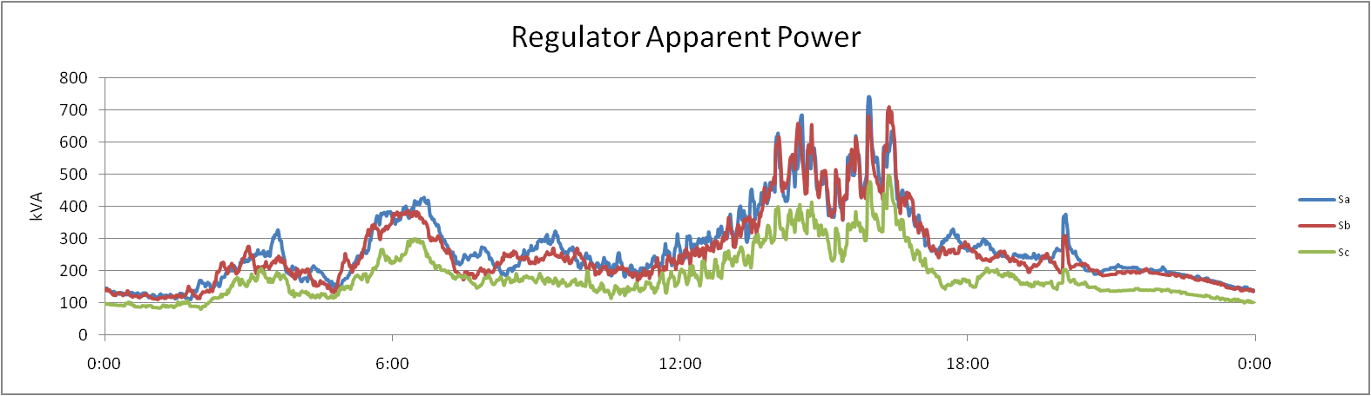
Daily Cycles

Slide 6
Weekly Cycles
Daily cycles: 24 hours

Slide 7
Seasonal Cycles
Daily cycles: 24 hours

